Slide 1
Dissociative Disorders
Somatic Symptom and Related Disorders

Slide 2
Dissociative Disorders
Dissociative disorder involve a disruption or dissociation of the functions of identity, memory, or consciousness that normally make us whole.
We see disturbances in the function of self, memory, consciousness that makes our personality whole.
The major dissociative disorders include:
Dissociative identity disorder
Dissociative amnesia
Depersonalization/derealization disorder.
Notes:
Watch the video Dissociative Disorders, Somatic Symptom and Related Disorders and Physiological Factors Affecting Physical Health (2:15) for an overview of dissociative disorders, and specifically, dissociative identity disorder.
https://mediaplayer.pearsoncmg.com/assets/mypsychlab-nevid10e-Dissociative_Identity_Disorder

Slide 3
Overview of Dissociative Disorders
Table 6.1 Overview of Dissociative Disorders
Type of Disorder | Approximate Lifetime Prevalence in Population | Description | Associated Features
Dissociative identity disorder | Unknown | Emergence of two or more distinct personalities | Alternates may vie for control May represent a psychological defense against severe childhood abuse or trauma
Dissociative amnesia | Unknown | Inability to recall important personal material that cannot be accounted for by medical causes | Information lost to memory is usually of traumatic or stressful experiences Subtypes include localized amnesia, selective amnesia, and generalized amnesia May be associated with dissociative fugue, a rare condition in which a person may travel to a new location and start a new life under a different identity
Depersonalization/ derealization disorder | 2% | Episodes of feeling detached from one’s self or one’s body or having a sense of unreality about one’s surroundings (derealization) | Person may feel as if he or she is living in a dream or acting like a robot Episodes of depersonalization are persistent or recurrent and cause significant distress
Source: Prevalence rates derived from American Psychiatric Association, 2013.

Slide 4
Dissociative Identity Disorder
Dissociative identity disorder – A dissociative disorder in which a person has two or more personalities.
Each personality has well-defined traits and memories.
Personalities may vie for control.
May or may not be aware of each other.
We see a splitting off of functions in identity, memory, consciousness.

Slide 5
Dissociative Identity Disorder: Controversies
Diagnosis of multiple personality is rare.
Existence of the disorder continues to arouse debate.
Many professionals express profound doubts about the diagnosis.
Culture-bound, largely restricted to North America.
Only a handful of cases worldwide reported from 1920 to 1970, but since then the number of reported cases has grown to thousands.
DISSOCIATIVE IDENTITY DISORDER. In dissociative identity disorder, multiple personalities emerge from within the same person, with each having its own well-defined traits and memories.

Slide 6
Clinical Features:
We see an emergence of two or more personalities that want control of the person.
There may be one dominant core personality
In some cases the host (main) personality is unaware of the other identities but the other identities are aware of the host.
In other cases – the the different personalities are unaware of the one another.
In some cases one personality may try to eliminate the other one – by ignoring the other one and not murdering it because then all of the personalities would be dead.
DID is culture bound and restricted to North America.
No cases have been reported in Japan and few in Europe.

Slide 7
Dissociative Amnesia
Dissociative amnesia – Memory loss without any identifiable organic cause.
Most common type of dissociative disorder.
May be unable to remember personal information, usually associated with traumatic events.
Memory loss is reversible, although it may last for days, weeks, or even years.
Notes:
Watch the video Sharon: Dissociative Amnesia (5:31) to learn more about Sharon’s personal experience with dissociative amnesia.
https://mediaplayer.pearsoncmg.com/assets/mypsychlab-AbnormalPsych-Sharon_Dissociative_Amnesia_edit

Slide 8
Dissociative Amnesia: Memory Problems
Dissociative amnesia is divided into five distinct types of memory problems:
Localized amnesia: events in one time period are lost after trauma.
Selective amnesia: you forget only the disturbing things during a specific period of time; one forgets a period when he had an extramarital affair.
Generalized amnesia: you forget your entire life; who you are, where you live etc.
Continuous amnesia: you forget everything that happens after a point in time to the present.
Systematized amnesia: memory loss is specific to a particular category of information such as memory about one’s family or people in the person’s life.

Slide 9
Dissociative Fugue
A rare subtype of dissociative amnesia is characterized by fugue, or “amnesia on the run.”
People in a fugue state may suddenly flee from their life situations, travel to a new location, assume a new identity, and have amnesia for personal information.
May show no signs of mental disturbance.
Fugue state may last for hours or days, or less common, for months or years.
You forget your personal information; you assume a new identity; you appear normal and show no signs of a mental disturbance
Suddenly one day your past identity emerges and they forget the events during the fugue state.

Slide 10
Depersonalization/Derealization Disorder
Depersonalization – A temporary loss or change in the usual sense of reality in which people feel detached from themselves and their surroundings.
Derealization – A sense of unreality about the external world involving odd changes in the perception of one’s surroundings or in the passage of time.
People and objects change in shape; sounds may seem different
DEPERSONALIZATION. Episodes of depersonalization are characterized by feelings of detachment from oneself. It may feel as if one is walking through a dream or observing the environment or oneself from outside one’s body.

Slide 11
Features of Depersonalization/Derealization Disorder
Table 6.3 Key Features of Depersonalization/Derealization Disorder
Repeated episodes of depersonalization, derealization, or both.
Episodes are characterized by feelings of detachment from one’s thoughts, feelings, or sensations (depersonalization) or from one’s surroundings (derealization).
Episodes may produce the feeling of being an outside observer of oneself.
Episodes may have a dreamlike quality.
During these episodes, a person can still distinguish reality from unreality.

Slide 12
Theoretical Perspectives: Brain Dysfunction
Research demonstrates structural differences in brain areas involved in memory and emotion between patients with dissociative identity disorder (DID) and healthy controls.
May be differences in brain metabolic activity between people with depersonalization disorder and healthy subjects.
Disruptive sleep patterns may result in dissociative experiences.

Slide 13
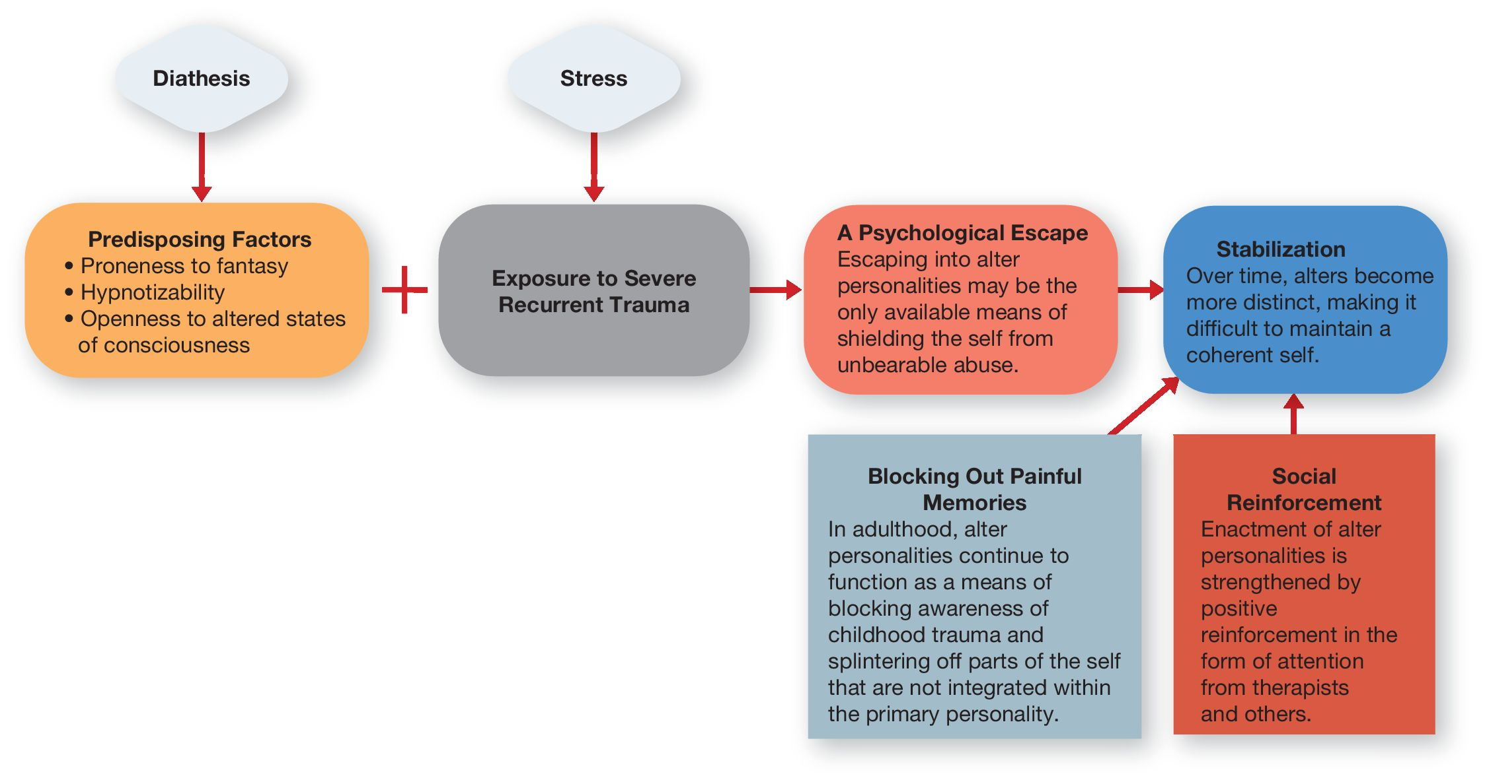
Diathesis-Stress Model of Dissociative Identity Disorder
Figure 6.1 Diathesis-stress model of dissociative identity disorder.
In this model, exposure to severe, recurrent trauma (stress), together with certain predisposing factors (diathesis), leads in some cases to the development of alter personalities, which over time become stabilized and strengthened by social reinforcement and blocking out of disturbing memories.

Slide 14
Treatment of Dissociative Disorders
Treatment of dissociative disorders that are recurrent or persistent is likely to involve focus on the anxiety and depression associated with the disorder.
Treatment for dissociative identity disorder focuses on integrating the alter personalities into a cohesive personality structure.
Therapists may seek to help patients uncover and work through memories of early childhood trauma.
If successful, person will no longer need to escape into alternate selves to avoid anxiety.

Slide 15
Somatic Symptom and Related Disorders
Somatic symptom and related disorders – Disorders characterized by complaints of physical problems or symptoms that cannot be explained by physical causes or have excessive concern about the nature or meaning of the symptoms.
Symptoms significantly interfere with daily functioning.
Based on assumption that psychological processes affect physical functioning.

Slide 16
Overview of Major Somatic Symptom and Related Disorders (1 of 2)
Table 6.4 Overview of Major Somatic Symptom and Related Disorders (Part 1 of 2)
Type of Disorder | Approximate Lifetime Prevalence in Population | Description | Associated Features
Somatic symptom disorder | Unknown, but may affect 5% to 7% of the general adult population | A pattern of abnormal behaviors, thoughts, or feelings relating to physical symptoms | Symptoms prompt frequent medical visits or cause significant impairment of functioning.
Illness anxiety disorder | Unknown | Preoccupation with the belief that one is seriously ill | Fear of illness persists despite medical reassurance to the contrary. Tendency to interpret physical sensations of minor aches and pains as signs of serious illness.
Source: Prevalence rates derived from American Psychiatric Association, 2013.

Slide 17
Overview of Major Somatic Symptom and Related Disorders (2 of 2)
Table 6.4 Overview of Major Somatic Symptom and Related Disorders (Part 2 of 2)
Type of Disorder | Approximate Lifetime Prevalence in Population | Description | Associated Features
Conversion disorder (functional neurological symptom disorder) | Unknown, but reported in 5% of patients referred to neurology clinics | Change in or loss of a physical function without medical cause | Emerges in context of conflicts or stressful experiences, which lends credence to its psychological origins. May be associated with la belle indifférence (indifference to symptoms).
Factitious disorder | Unknown, but an estimated 1% of medical patients in hospital settings may qualify for the diagnosis | Faking or manufacturing physical or psychological symptoms without any apparent motive | Unlike malingering, the symptoms do not result in any obvious gain. There are two major types: factitious disorder imposed on self (fabricating or inducing symptoms in oneself, generally called Münchausen syndrome) and factitious disorder imposed on another (fabricating or inducing symptoms in others).
Source: Prevalence rates derived from American Psychiatric Association, 2013.

Slide 18
Somatic Symptom Disorder
Somatic symptom disorder (SSD) – Troubling physical symptoms and excessive concern about the symptoms to the extent that it affects thoughts, feelings, and behaviors in daily life.
Diagnosis of SSD:
Physical symptoms must be persistent, lasting typically for a period of 6 months or longer.
Physical symptoms must cause personal distress or interfere with daily functioning.

Slide 19
Illness Anxiety Disorder
Illness anxiety disorder (IAD) – Applies to a subgroup of people with hypochondriasis who complain of relatively minor or mild symptoms they take to be signs of a serious undiagnosed illness.
A preoccupation with the belief that one is seriously ill.
Emphasis is placed on the anxiety associated with illness rather than the distress the symptoms cause.
Two general subtypes of the disorder are the care-avoidant subtype and the care-seeking subtype.
Notes:
Watch the video Henry: Hypochondriasis (3:39) to learn more about somatic symptom disorder.
https://mediaplayer.pearsoncmg.com/assets/mypsychlab-MPL-HenryHypochondriasis

Slide 20
Conversion Disorder
Conversion disorder – Characterized by symptoms or deficits that affect the ability to control voluntary movements or that impair sensory functions, such as an inability to see, hear, or feel tactile stimulation.
Called functional neurological symptom disorder in the DSM-5.
Loss or impairment of physical function that is not explained by medical conditions or disease.
Believed to involve the conversion or transformation of emotional distress into significant symptoms in the motor or sensory domain.

Slide 21
Factitious Disorder
Factitious disorder – characterized by intentional fabrication of psychological or physical symptoms for no apparent gain.
Two subtypes:
Factitious disorder imposed on self – Faking symptoms in oneself (also known as Münchausen syndrome).
Factitious disorder imposed on another – The inducing of physical or emotional illness in another person, typically a child or dependent person (also known as Münchausen syndrome by proxy).

Slide 22
Treatment of Somatoform Disorders
Psychoanalysis – seeks to uncover and bring unconscious conflicts that originated in childhood into conscious awareness.
Behavioral approach – focuses on removing sources of secondary reinforcement that may become connected with physical complaints.
Cognitive-behavioral therapy – restructures distorted thinking and replaces exaggerated beliefs with rational alternatives.

