Slide 1
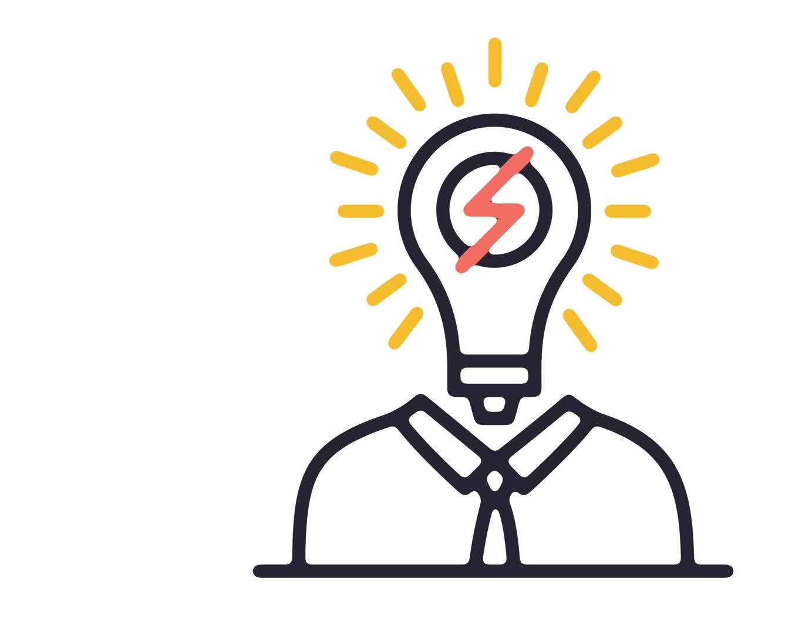
Implicit Bias
The term implicit bias was first coined in 1995 by psychologists Mahzarin Banaji and Anthony Greenwald, where they argued that social behavior is largely influenced by unconscious associations and judgments.

Slide 2
Implicit biases are unconscious attitudes and stereotypes that are revealed in various domains such as in criminal justice, employment setting, healthcare, race, socioeconomic status, gender, sexuality.
Implicit bias is synonymous with unconscious bias.
Some of these biases are the outcome of our brain attempting to identify consistent patterns of behavior in others; relieving us of having to deal with a complex world.
We may act on our implicit biases, attitudes and preferences and not realize we’ve treated the individual in a disrespectful, discriminatory way.

Slide 3
Understanding Unconscious Bias
https://www.youtube.com/watch?v=dVp9Z5k0dEE&t=12s

Slide 4
Kahneman (2011) distinguishes between two types of thinking: system 1 and system 2.
System 1 is the brain's fast, emotional, unconscious thinking mode.
Implicit biases are examples of System 1 Thinking
This type of thinking requires little effort, but it is often error prone.
Most everyday activities (like driving, talking, cleaning, etc.) make heavy use of the type 1 system.
The type 2 system is slow, logical, effortful, conscious thought, where reason dominates.

Slide 5
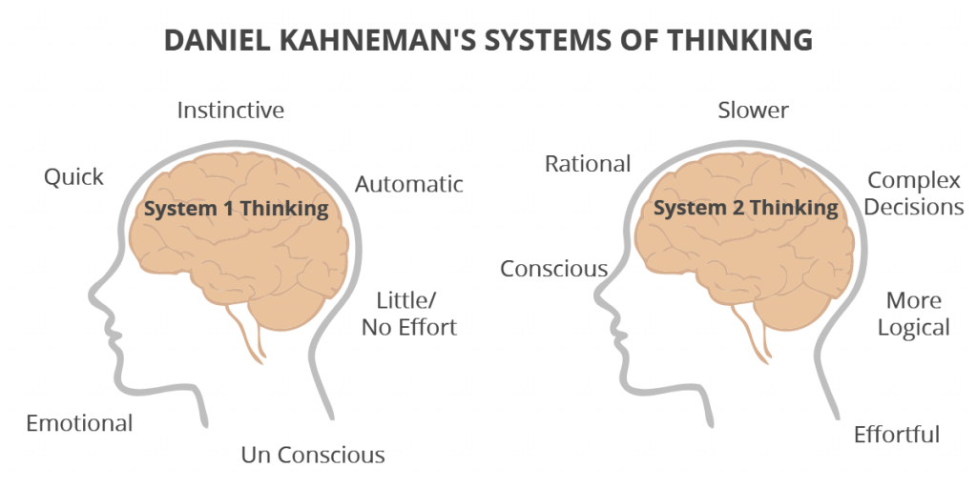

Slide 6
We Like to Take Mental Shortcuts
Implicit biases can be perceived as taking cognitive shortcuts.
Our urgency driven and hurried society creates stress in our lives and leaves us susceptible to using biases to sort/filter all the overwhelming data.
In general we all search for strategies to simplify our world.
In the end, we tend to act on our biases, using them as a theory to navigate through our complex world.

Slide 7
Causes of Implicit Bias
We’re likely create biases because of tendencies to create patterns
Our brains have a natural tendency to seek patterns and associations to make sense of a very complicated world.
Studies reveal that before kindergarten, children rely on their group membership (e.g., racial group, gender group, age group, etc.) to guide perceptions about others.
Children establish patterns and recognize what distinguishes them from others.
Children may conclude that "what is similar to me is good, and what is different from me is bad”
Perceiving how you are different than others may result in forming negative perceptions of the outgroups resulting in implicit biases.

Slide 8
What Are the Implications of Unconscious Bias?
We see implicit biases emerge in many sectors of society.
Our daily interactions may contain implicit biases.
This occurs when certain actions (or microaggressions) make others feel uncomfortable or aware of the specific prejudices you may hold against them.
Racial Stereotypes
Implicit bias can be expressed as unconscious racial stereotypes.
One may not be aware they harbor an automatic preference for one race over another.

Slide 9
What IS IMPLICIT BIAS IN HEALTHCARE?
Implicit bias can influence how health care providers interact with patients.
In September 2020, the Regenstrief Institute published data from the Department of Veterans Affairs (VA) revealing that veterans seeking mental health treatment sensed non-verbal cues that showed implicit bias.
The survey of 85 Black veterans showed that most had good patient-provider relationships, but many sensed that race could play a role in their healthcare.
“They explained that structural characteristics such as the physical space of an institution project how welcoming an institution might be to minority patients, and that staff diversity, especially in position of power, reflects the facility’s values and culture related to racial equity”
Some patients reported feeling stereotyped by mental health providers; that clinicians were distant.
Some participants also shared that because of their physical appearance, they felt stereotyped as angry, big Black men
They explained that some providers viewed them as a physical threat and react fearfully.
Racial and ethnic minorities; women are more likely to receive an inaccurate diagnosis, fewer treatment options and poorer clinical outcomes.
Black children may receive suboptimal care compared to White children.

Slide 10
How does implicit bias influence health care?
https://www.youtube.com/watch?v=ze7Fff2YKfM&t=34s

Slide 11
We should always receive good healthcare, regardless of personal characteristics, identities, or traits such as race or gender.
Undoubtedly, implicit biases surface healthcare and they can negatively affect the quality of healthcare one receives.
Health care providers strive to provide impartial care to their patients.
However, we know a percentage of patients receive differing quality of healthcare resulting from biases of their health care providers.

Slide 12
Biases can lead to arriving at an inaccurate diagnosis, delays in treatment and related procedures.
Delays in treatment can produce additional worry and stress on the patient.
Implicit bias can have adverse consequences on:
-- patient experience, health outcome
A patient may sense a provider’s implicit bias and may be less motivated to develop a meaningful relationship with their provider.

Slide 13
Gender Stereotypes
Gender biases seem to be a common form of implicit bias.
Gender biases are products of how we perceive men and women based on traditional feminine and masculine traits and characteristics.
For example, we tend to assign fame more often to males than females.
In academia, females are more likely to be perceived as having stronger language skills than math, and males are more likely stronger in math than language skills.
This bias may influence one’s career ambitions/jobs.

Slide 14
Racial Groups
In 2019 National Healthcare and Disparities Report found that white patients were more likely to receive better quality care than:
Black patients
Native American patients
Alaska Native patients
Hispanic patients
Native Hawaiian/Pacific Islander patients
A person of color may have delays in treatment, leading to poorer outcomes.
In 2016 a study revealed that some physicians were significantly more likely to recommend white patients for bypass surgery than Black patients.
This conclusion was attributed to the physicians’ belief that their Black patients were less educated and therefore not follow through with their post-operative treatment.

Slide 15
Socioeconomic Status
Studies suggest that some physicians may think that people from low socioeconomic backgrounds are:
Less intelligent
Less independent
Less responsible
Not likely to comply with treatment protocols and keep follow up appointments.
Studies also suggest that some physicians were more likely to delay testing and not make referrals for specialty treatments among patients from low socioeconomic statuses.

Slide 16
LGBTQ+ Community Bias
People may hold implicit biases against members of the LGBTQ+ community.
Remember --- these biases are unconscious.
Example: Asking a female friend if she has a boyfriend, assuming her sexuality is heterosexual.
One could just ask if she is seeing someone.

Slide 17
Work
Implicit biases can also be revealed in the workplace.
One study examined who received more calls for interviews based on stereotypical Black and White names.
Whites received 50% more calls for interviews than applicants with stereotypical Black names.
We refer to this phenomenon as a form of hiring bias.
Anglicized named applicants can be expected to receive calls for interviews compared to ethnic named applicants.

Slide 18
Social and Cultural Influences
The media, culture and one’s rearing/socialization experiences can create implicit associations we form.
Social media can influence development of implicit biases.
Television, journal articles and magazines can also produce implicit biases.
Some may associate minorities with criminal behavior, gang involvement and other deviant activities.
Studies have documented that racial attitudes of parents influence their children’s development of prejudicial attitudes.

Slide 19
Education is crucial.
Understanding what represents implicit biases, how they emerge and how to recognize them in ourselves is critical in their removal.
Increasing our knowledge of other cultures, our language and how our actions can be offensive is critical.
Education is a powerful tool; we can educate through books, print and social media, advocacy.
Organizations must work to remove health disparities by offering training on implicit bias and cultural competency.

