Slide 1
Bipolar and Related Disorders

Slide 2
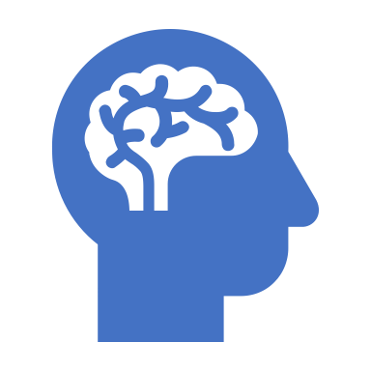
Bipolar disorder occurs in up to 2.5% of the population, but the prevalence is much higher among first-degree relatives of individuals with bipolar
Bipolar disorder, formerly called manic depression, is a mental health condition that causes extreme mood swings that include emotional highs (mania or hypomania) and lows (depression).
When you become depressed, you may feel sad or hopeless and lose interest or pleasure in most activities.
When your mood shifts to mania or hypomania (less extreme than mania), you may feel euphoric, full of energy or unusually irritable.
These mood swings can affect sleep, energy, activity, judgment, behavior and the ability to think clearly.
Episodes of mood swings may occur rarely or multiple times a year.
Although bipolar disorder is a lifelong condition, you can manage your mood swings and other symptoms by following a treatment plan.
In most cases, bipolar disorder is treated with medications and psychotherapy.

Slide 3
Three forms:
Bipolar I, Bipolar II, and Cyclothymia
Mania defining feature of each
Differentiated by severity and duration of mania
Usually involve episodes of depression alternating with mania
Depressive episode required for Bipolar II
Mania
State of intense elation or irritability
Hypomania (hypo = “under”)
Symptoms of mania but less intense
Does not involve significant impairment, mania does

Slide 5
DSM-5 Criteria for Manic and Hypomanic Episodes
Distinctly elevated or irritable mood for most of the day nearly every day
Abnormally increased activity and energy
At least three of the following are noticeably changed from baseline:
Increase in goal-directed activity or psychomotor agitation
Unusual talkativeness; rapid speech
Flight of ideas or subjective impression that thoughts are racing
Decreased need for sleep
Increased self-esteem; belief that one has special talents, powers, or abilities
Distractibility; attention easily diverted
Excessive involvement in activities that are likely to have undesirable consequences, such as reckless spending, sexual behavior, or driving
For a manic episode:
Symptoms last for 1 week or require hospitalization
Symptoms cause significant distress or functional impairment
For a hypomanic episode:
Symptoms last at least 4 days
Clear changes in functioning that are observable to others, but impairment is not marked
No psychotic symptoms are present

Slide 6
Bipolar Disorders
Bipolar I
At least one episode of acute mania (full mania) and may or may not have a depressive episode.
Bipolar II
At least one major depressive episode (severe) with at least one episode of hypomania
The difference between Type I and II is the severity of the manic episodes and depression.
Cyclothymic Disorder (Cyclothymia)
Milder, chronic form of bipolar disorder
Lasts at least 2 years in adults, 1 year in children/adolescents
Numerous periods with hypomanic and depressive symptoms
Does not meet criteria for mania or major depressive episode
Symptoms do not clear for more than 2 months at a time

Slide 7
Cyclothymia
Cyclothymic disorder – Chronic cyclical pattern of mild mood swings lasting at least two years.
Usually begins in late adolescence or early adulthood.
Elevated or depressed mood not severe enough for diagnosis of bipolar disorder.
Some forms of cyclothymic disorder may represent a mild, early type of bipolar disorder.
Approximately one in three people with cyclothymic disorder eventually go on to develop bipolar disorder.

Slide 8
Etiology of Mood Disorders
Neurotransmitters (NTs): involve norepinephrine, dopamine, and serotonin
Major Depressive Disorder
Low levels of norepinephrine, dopamine, and serotonin
Mania
High levels of norepinephrine and dopamine, low levels of serotonin
Medication alters levels but relief takes 2-3 weeks

Slide 9
Etiology: Social & Environmental Factors
Life events
Prospective research
42-67% report a stressful life event in year prior to depression onset
e.g., romantic breakup, loss of job, death of loved one
Replicated in 12 studies across 6 countries
Lack of social support may be one reason a stressor triggers depression
Behavior of depressed people often leads to rejection by others
Excessive reassurance seeking
Few positive facial expressions
Negative self disclosures
Slow speech and long silences

Slide 10
Etiology: Psychological Factors
Cognitive theories
Beck’s Theory
Negative triad: negative view of self, world, future
Negative schema: underlying tendency to see the world negatively
Negative schema cause cognitive biases: tendency to process information in negative ways
Hopelessness Theory
Most important trigger of depression is hopelessness
Desirable outcomes will not occur
Person has no ability to change situation
Attributional Style
Stable and Global attributions can cause hopelessness
Rumination Theory
A specific way of thinking: tendency to repetitively dwell on sad thoughts
Most detrimental is to brood over causes of events

Slide 11
Attribution Theory: the way people think about the causes of their successes and failures in life was what really mattered-- it’s what they attribute it to that‘s meaningful Be aware of the language you use: If you use words like always and never when talking about unfavorable events in your life → you will likely be a pessimist If you use words like sometimes and lately as qualifiers you can blame unfavorable events on transient conditions and have an optimistic style Try to get accustomed to using words like: probable, highly probable, likely, highly likely, less likely, to the extent that ….. Permanence: refers to people who give up easily because they believe the causes of bad events happening to them are permanent-- they believe it will persist and always affect their lives. Optimism: optimistic people explain good events to themselves in terms of permanent causes like their abilities and traits

Slide 12
People who believe positive events are attributed to permanent causes such as their skills and effort try harder after they succeed. Pervasiveness: people who make universal explanations for their failures give up on everything when failure comes in one area of their life. People who make specific explanations may become helpless in that one area of their life and move on with their life. Universal Explanations: these produce helplessness across many situations and specific explanations produce helplessness only in the problem area. Permanent causes produce helplessness far into the future and universal causes produce helplessness throughout life.

Slide 13
Psychotherapy and Complementary Approaches
Interpersonal psychotherapy (IPT)
Short-term psychodynamic therapy
Focus on current relationships
Cognitive therapy
Monitor and identify automatic thoughts
Replace negative thoughts with more neutral or positive thoughts
Challenging irrational thoughts about self
Mindfulness-based cognitive therapy (MBCT)
Strategies, including meditation, to prevent relapse
Behavioral activation (BA) therapy
Increase participation in positively reinforcing activities to disrupt spiral of depression, withdrawal, and avoidance

Slide 14
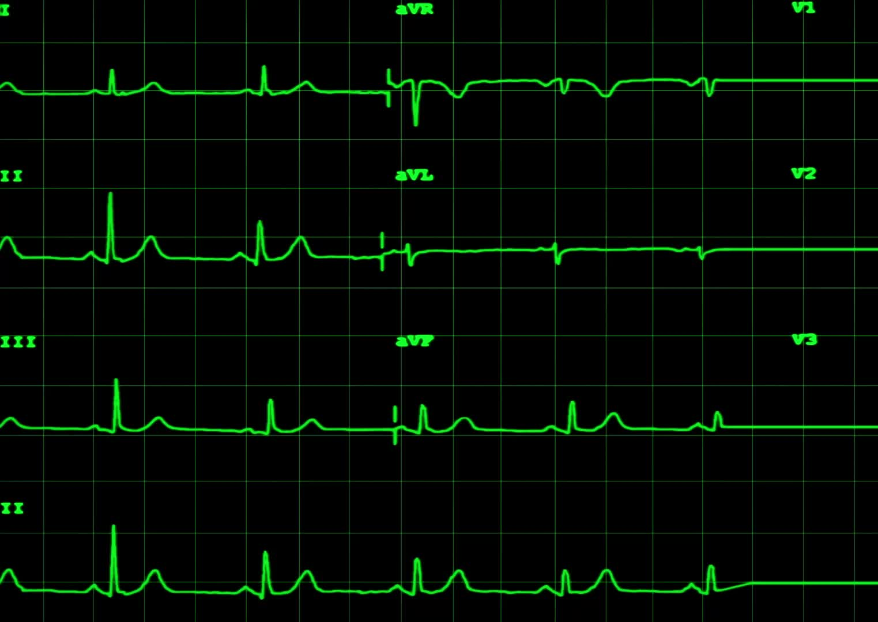
Electroconvulsive therapy (ECT)
Reserved for treatment non-responders
Induce brain seizure and momentary unconsciousness
Side effects
Memory loss
ECT more effective than medications
Unclear how ECT works

Slide 15
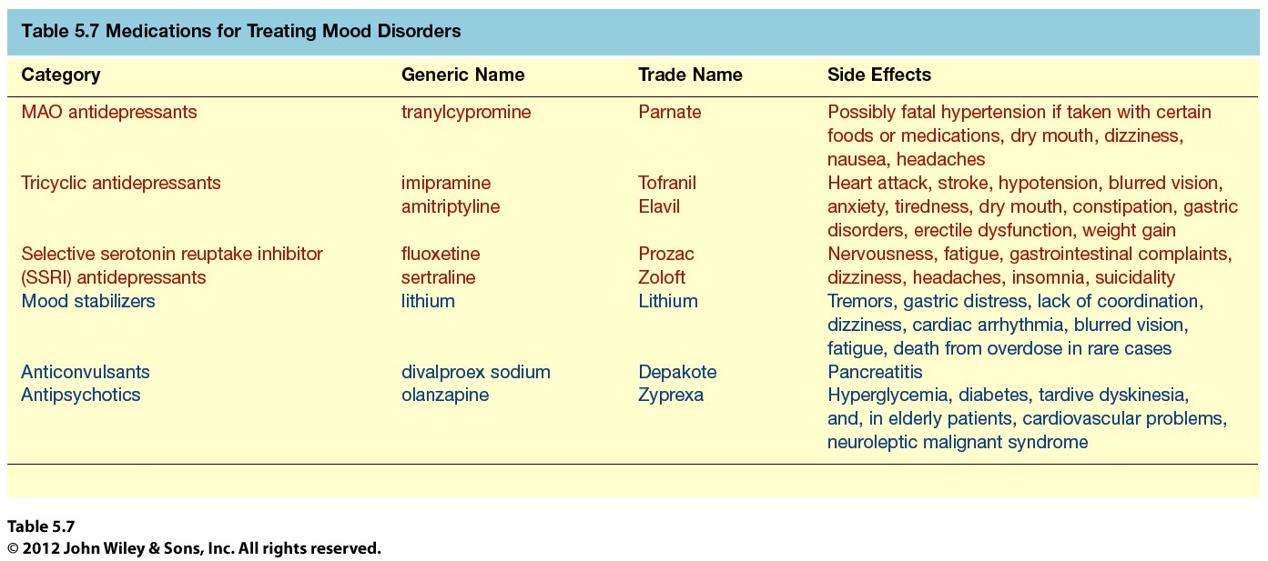

Slide 16
Lithium
Up to 80% receive at least some relief with this mood stabilizer
Potentially serious side effect
Lithium toxicity
Newer mood stabilizers
Anticonvulsants
Depakote
Antipsychotics
Zyprexa
Both also have side effects:
Drowsiness
Akinesia
Weight gain
Abdominal Pain
Loss of Appetite
Diarrhea Nausea
Dizziness Hair Loss
Constipation Blurred Vision

