Slide 1
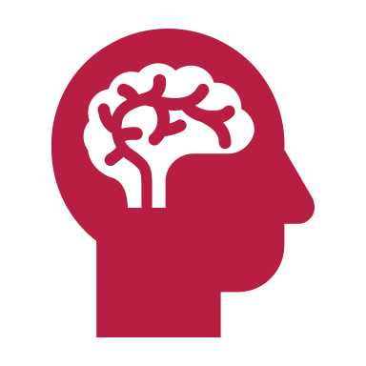
Social Media and Mental Health
The American Academy of Pediatrics has warned about the potential for negative effects of social media in young kids and teens, including cyber-bullying and "Facebook depression."
But the same risks may be true for adults, across generations.

Slide 2
What is social media
Social media refers to the means of interactions among people in which they create, share, and/or exchange information and ideas in virtual communities and networks.
Popular Social Media Tools and Platforms:
Blogs: A platform for casual dialogue and discussions on a specific topic or opinion.
Facebook: The world’s largest social network, with more than 3.03 billion monthly active users (as of 2023). Users create a personal profile, add other users as friends, and exchange messages, including status updates. Brands create pages and Facebook users can “like” brands’ pages.
Snapchat: pictures and messages are usually only available for a short time before they become inaccessible to their recipients.
X/Twitter: A social networking/micro-blogging platform that allows groups and individuals to stay connected through the exchange of short status messages (280 character limit).
Instagram: A free photo and video sharing app that allows users to apply digital filters, frames and special effects to their photos and then share them on a variety of social networking sites.
LinkedIn: A place where groups of professionals with similar areas of interest can share information and participate in a conversations.
YouTube/Vimeo: Video hosting and watching websites.
Tik Tok: a social media platform that allows users to create, share, and discover short videos. Users can express themselves through singing, dancing, comedy, and lip-syncing, and can use filters, stickers, voiceovers, and sound effects to get creative.

Slide 3
It is Addictive
Experts have not been in total agreement on whether internet addiction is a real thing, let alone social media addiction, but there’s some good evidence that both may exist.
A study from Nottingham Trent University looked back over earlier research on psychological characteristics, personality and social media use.
The authors conclude that “it may be plausible to speak specifically of ‘Facebook Addiction Disorder’…because addiction criteria, such as neglect of personal life, mental preoccupation, escapism, mood modifying experiences, tolerance and concealing the addictive behavior, appear to be present in some people who use [social networks] excessively.”

Slide 4
Studies have confirmed that people tend to undergo a kind of withdrawal.
A study a few years ago from Swansea University found that people experienced the psychological symptoms of withdrawal when they stopped using (this went for all internet use, not just social media).
Their recent follow-up study found that when people stop using, they also undergo small but measurable physiological effects.
Study author Phil Reed said, “We have known for some time that people who are over-dependent on digital devices report feelings of anxiety when they are stopped from using them, but now we can see that these psychological effects are accompanied by actual physiological changes.”
Whether this is true of social media per se is unclear right now, but anecdotal evidence suggests it may be.

Slide 5
It Triggers More Sadness, Less Well-Being
The more we use social media, the less happy we seem to be.
One study a few years ago found that Facebook use was linked to both less moment-to-moment happiness and less life satisfaction.
The authors suggest this may have to do with the fact that Facebook conjures up a perception of social isolation, in a way that other solitary activities don’t.
Facebook provides an invaluable resource for fulfilling needs by allowing people to instantly connect.
Rather than enhancing well-being, as frequent interactions with supportive 'offline' social networks powerfully do, the current findings demonstrate that interacting with Facebook may predict the opposite result for young adults—it may undermine it.

Slide 6
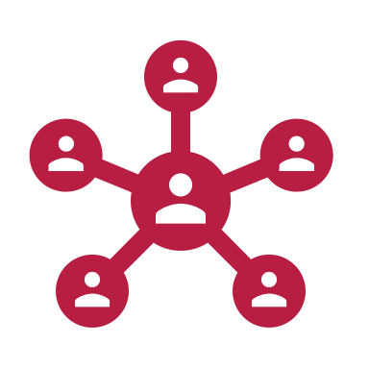
Another study found that social media use is linked to greater feelings of social isolation.
The team looked at how much people used 11 social media sites, including Facebook, Twitter, Google+, YouTube, LinkedIn, Instagram, Pinterest, Tumblr, Vine, Snapchat and Reddit, and correlated this with their “perceived social isolation.”
Not surprisingly, it turned out that the more time people spent on these sites, the more socially isolated they perceived themselves to be.
And perceived social isolation is one of the worst things for us, mentally and physically.

Slide 7
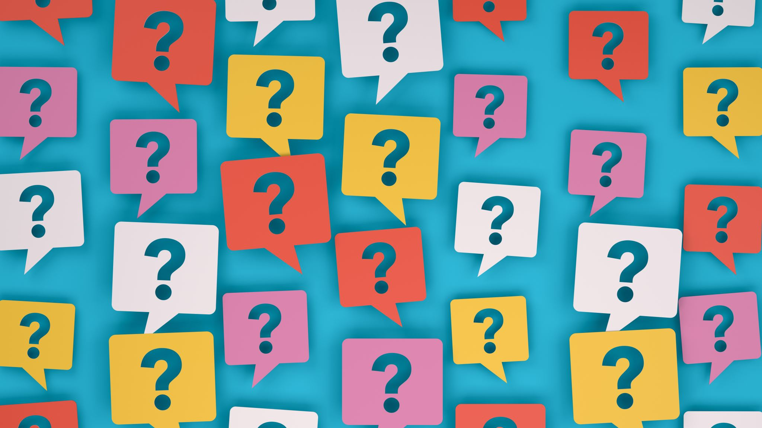
Comparing Our Lives To Others is Unhealthy
Part of the reason Facebook makes people feel socially isolated is the comparison factor.
We fall into the trap of comparing ourselves to others as we scroll through our feeds, and make judgements about how we measure up.
One study looked at how we make comparisons to others posts, in “upward” or “downward” directions—that is, feeling that we’re either better or worse off than our friends.
It turned out that both types of comparisons made people feel worse, which is surprising, since in real life, only upward comparisons (feeling another person has it better than you) makes people feel bad.
But in the social network world, it seems that any kind of comparison is linked to depressive symptoms.

Slide 8
It Can Lead to Jealousy and a Vicious Cycle
It’s no secret that the comparison factor in social media leads to jealousy—most people will admit that seeing other people’s tropical vacations and perfectly behaved kids is envy-inducing.
Studies have certainly shown that social media use triggers feelings of jealousy.
The authors of one study, looking at jealousy and other negative feelings while using Facebook, wrote that “This magnitude of envy incidents taking place on FB alone is astounding, providing evidence that FB offers a breeding ground for invidious feelings."
They add that it can become a vicious cycle: feeling jealous can make a person want to make his or her own life look better, and post jealousy-inducing posts of their own, in an endless circle of one-upping and feeling jealous.

Slide 9
We Get Caught in the Delusion of Thinking it Will Help
Part of the unhealthy cycle is that we keep coming back to social media, even though it doesn’t make us feel very good.
This is probably because of what’s known as a forecasting error: Like a drug, we think getting a fix will help, but it actually makes us feel worse, which comes down to an error in our ability to predict our own response.
One study looked at how people feel after using Facebook and how they think they’ll feel going in.
Like other studies suggested, the participants in this one almost always felt worse after using it, compared to people engaging in other activities.
But a follow-up experiment showed that people generally believed that they’d feel better after using, not worse.
Which of course turns out not to be the case at all, and sounds a lot like the pattern in other types of addiction.

Slide 10
More Friends on Social Doesn’t Mean You’re More Social
A couple of years ago, a study found that more friends on social media doesn’t necessarily mean you have a better social life.
There seems to be a cap on the number of friends a person’s brain can handle, and it takes actual social interaction (not virtual) to keep up these friendships.
So feeling like you’re being social by being on Facebook doesn’t work.
Since loneliness is linked to myriad health and mental health problems (including early death), getting real social support is important.
Virtual friend time doesn’t have the therapeutic effect as time with real friends.

Slide 11
All of this is not to say that there’s no benefit to social media.
But getting on social media when you have some time to kill, or, worse, need an emotional lift, is likely a bad idea.
Obviously it keeps us connected across great distances, and helps us find people we’d lost touch with years ago.
Studies have found that taking a break from Facebook helps boost psychological well-being.
If you're feeling brave, try taking a little break, and see how it goes.
If you're going to keep "using," then at least try to use in moderation.

Slide 12
Cultures inform how we understand our relationships and interact with other people.
One of the most widely-recognized distinctions between types of cultures is that between individualism and collectivism.
Individualism values personal independence.
Within individualist cultures, people are more likely to “see themselves as separate from others, define themselves based on their personal traits, and see their characteristics as relatively stable and unchanging.”
An individualist’s sense of self is defined more by who they are on the “inside,” minimizing the influence of factors, contexts, and people “outside” the individual.
Individualists tend to communicate in direct styles —they say what they mean, prioritizing that information is conveyed explicitly and unambiguously. European and “Western” cultures are typically more individualist.

Slide 13
Collectivism values personal interdependence.
In collectivist cultures, people are more likely to “see themselves as connected to others, define themselves in terms of relationships with others, and see their characteristics as more likely to change across different contexts.”
A collectivist’s sense of self is defined more by who they are with other people, or by their membership in a group.
Maintaining social harmony, getting along with others, and meeting social expectations are more important in collectivist cultures.
They tend to communicate in indirect styles—collectivists imply what they really mean, but might say otherwise to avoid conflict or embarrassment.
Asian and African cultures tend to be more collectivist, for example.
The individualist idea of having a more immutable, authentic private self is not as appealing in collectivist cultures.
Individualist self-expressions and styles may even seem selfish, disruptive, or alienating to a more collectivist person or group.
Inversely, the collectivist priority for social agreement and cooperation may seem stiflingly conformist to someone who’s more individualist.

Slide 14
Just because someone’s cultural background is individualist, you shouldn’t assume that they are.
Everyone falls somewhere on the individualist-collectivist spectrum.
Even within a very collectivist culture, you will find people who are more individualist.
Furthermore, psychology research has shown that people shift along this spectrum, leaning more collectivist or individualist depending on the situation.
This adaptability is more common in multicultural communities and contexts.
It’s partly why we seek intercultural exchange: to adopt multiple cultural frames and learn to apply them in relevant communities and circumstances.

