Slide 1
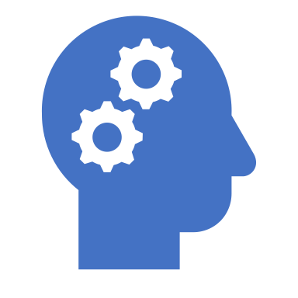
Common Cognitive Biases

Slide 2
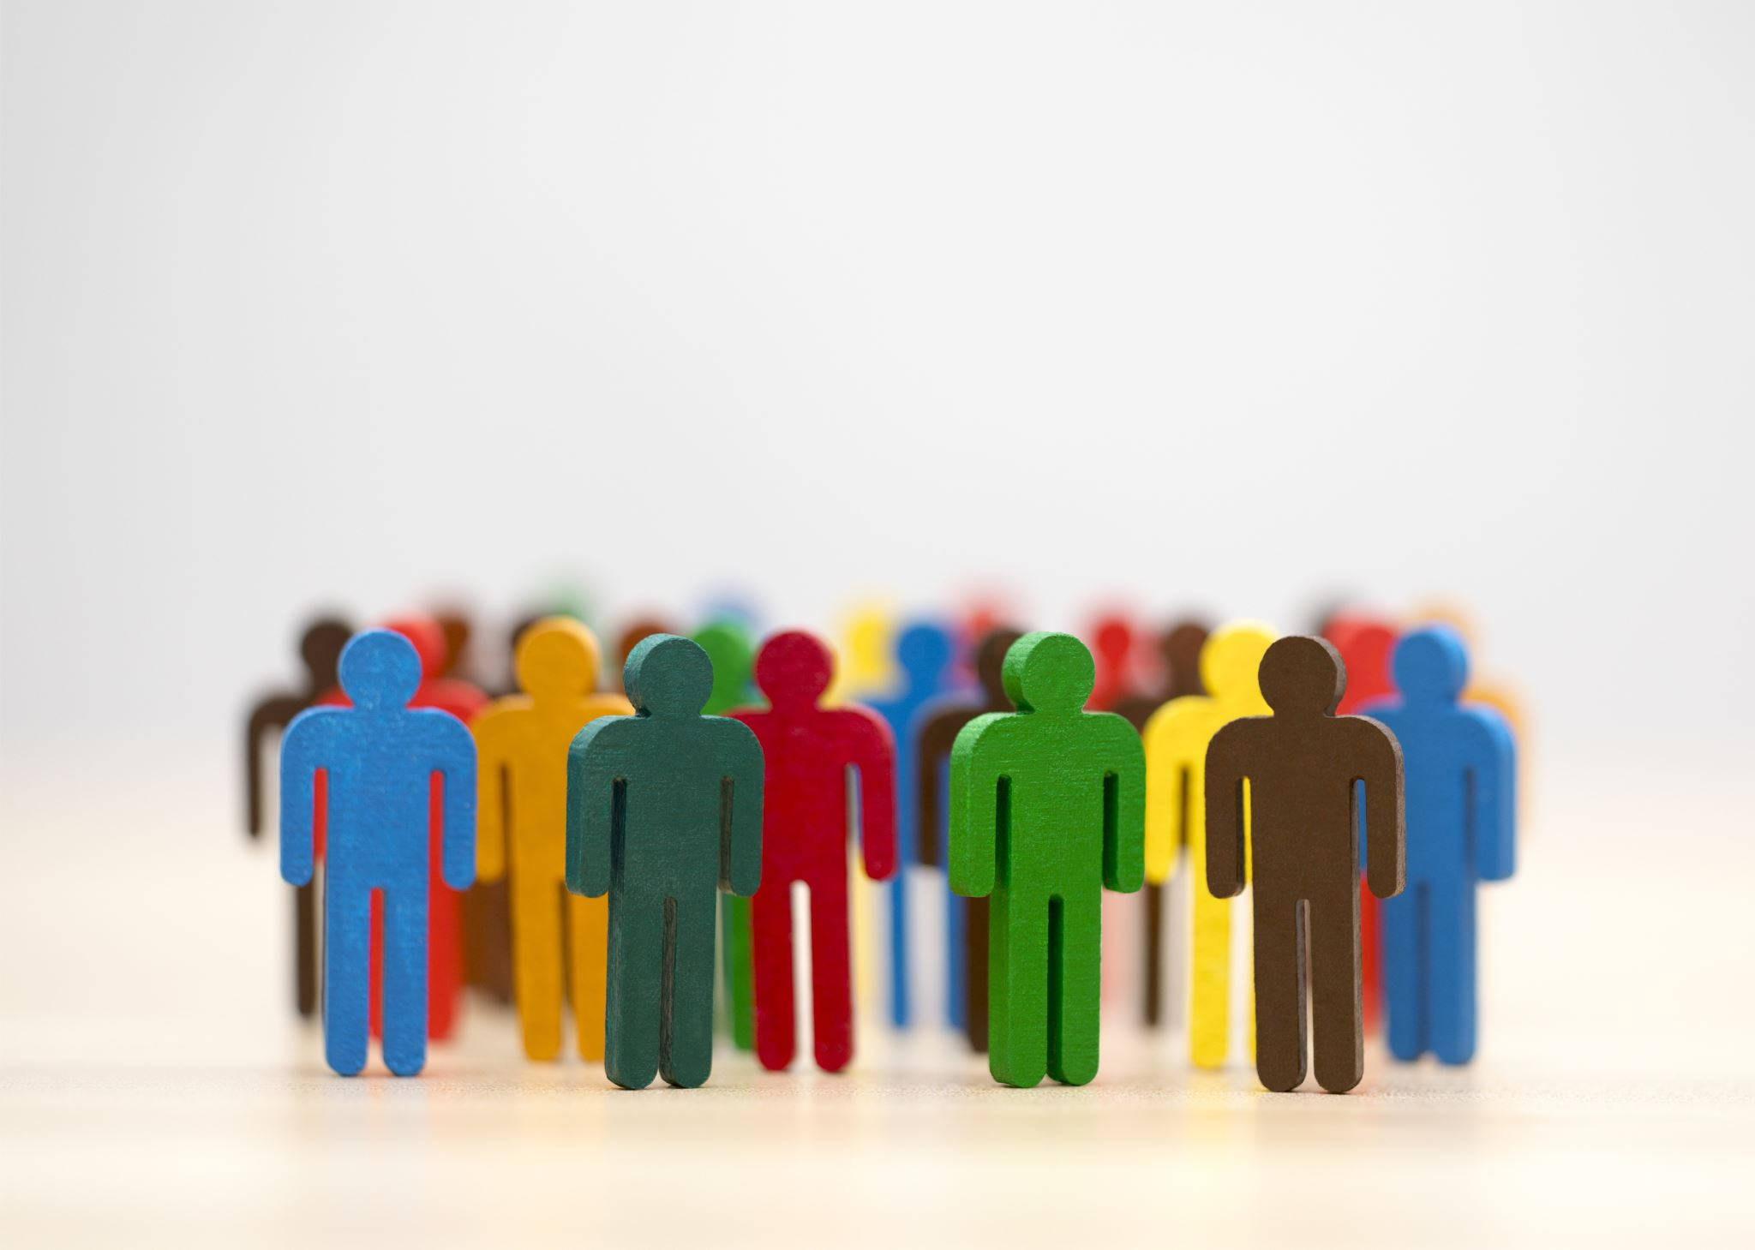
While people like to believe that they are rational and logical, the fact is that people are continually under the influence of cognitive biases.
These biases distort thinking and influence our beliefs, sway the decisions and judgments that people make each and every day.

Slide 3
Confirmation Bias is the tendency to listen more often to information that confirms our existing beliefs.
We tend to favor information that reinforces the things we already think or believe.
It helps protect self-esteem by making people feel that their beliefs are accurate.
Examples include:
Only paying attention to information that confirms your beliefs about issues such as gun control and global warming
Only following people on social media who share your viewpoints
Choosing news sources that present stories that support your views
Refusing to listen to the opposing side.
Not considering all of the facts in a logical and rational manner

Slide 4
The Halo Effect
The halo effect is the tendency for an initial impression of a person to influence what we think of them overall.
Also known as the "physical attractiveness stereotype" or the "what is beautiful is 'good' principle
For example:
Thinking people who are good-looking are also smarter, kinder, and funnier than less attractive people
Believing that products marketed by attractive people are also more valuable
Thinking that a political candidate who is confident must also be intelligent and competent

Slide 5
The Self-Serving Bias
The self-serving bias is a tendency for people tend to give themselves credit for successes but lay the blame for failures on outside causes.
When you do well on a project, you probably assume that it’s because you worked hard.
But when things turn out badly, you are more likely to blame it on circumstances or bad luck.
Some examples of this:
Attributing good grades to being smart or studying hard
Believing your athletic performance is due to practice and hard work
Blaming your professor for performing badly on a test

Slide 6
The Availability Heuristic
The availability heuristic is the tendency to estimate the probability of something happening based on how many examples readily come to mind.
Some examples of this:
After seeing several news reports of car thefts in your neighborhood, you might start to believe that such crimes are more common than they are.
You might believe that plane crashes are more common than they really are because you can easily think of several examples.
It is essentially a mental shortcut designed to save us time when we are trying to determine risk.
The problem with relying on this way of thinking is that it often leads to poor estimates and bad decisions.
Smokers who have never known someone to die of a smoking-related illness, for example, might underestimate the health risks of smoking.

Slide 7
The Optimism Bias
The optimism bias is a tendency to overestimate the likelihood that good things will happen to us while underestimating the probability that negative events will impact our lives.
Essentially, we tend to be too optimistic for our own good.
For example, we may assume that negative events won't affect us such as:
Divorce
Job loss
Illness
Death

